Slide 1
REST + HATEOAS
A Brief Overview

Slide 2

Who Am I?
{
“name”:”Blake Rhodes”,
“Title”:”Senior Sofware Engineer”,
"_links": {
"self": {
"href": http://https://github.com/BlakeRhodes"
},
“company”: {
"href": "https://vizientinc.com"
}
}
}

Slide 3




Richardson Maturity Model
SOAP and RCP
Uniform Resource Identifier
Http Methods for Entities
Metadata about Entities

Slide 4

What is REST?
REpresentational State Transfer
Client–Server
Stateless
Cacheable
Uniform interface
Layered system

Slide 5

Why use REST?
Consistent
Cacheable
Versionable
Platform Independent
Scalable
Makes you look smart and handsome

Slide 6
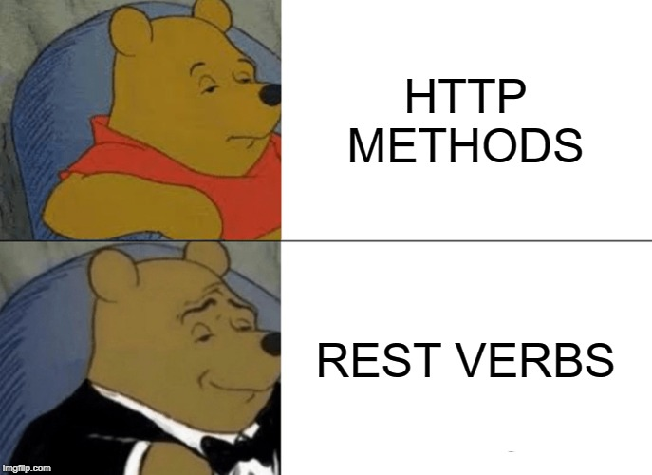
How should REST?
Be Consistent
Create Resources First
Nouns Not Verbs
GET, PUT, POST, DELETE
Versioning
Consistent Status Codes
Paging is (Probably) Required
Filtering is Nice

Slide 7
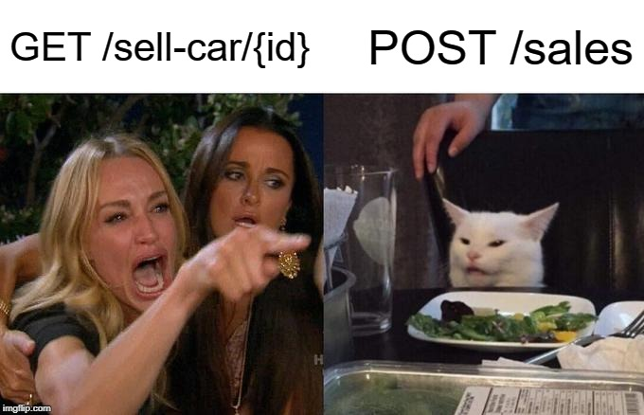
Nouns Not Verbs
Think Resources
/car
/cars
/cars/X/owners/Y/names

Slide 8

Controller Verbs
GET – Overload this: /cars = all cars, /cars/X = car #X
POST – Adds a resource
PUT – Updates a resource
DELETE – Removes a resource
GET, PUT, DELETE are idempotent, POST is not
PATCH

Slide 9
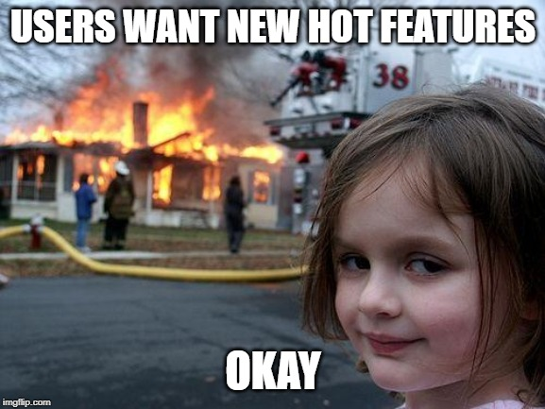
Versioning
api/cars
api/v1/cars
Supports change
Multiple Ways to Version
Headers/Content Negotiation
Resources can know their versions

Slide 10
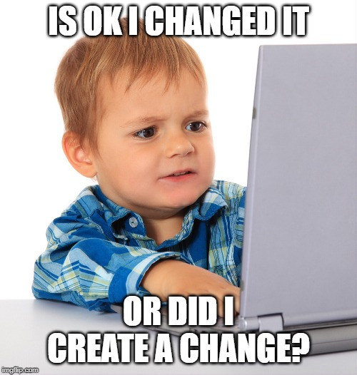
Status
200 (OK) – Everything is cool, here’s your resource
201 (Created) – Everything is cool, I saved it (want a copy?)
202 (Accepted) – Working on it, check back later here
404 (Not Found)
204 (No Content) – Sure
PUT is weird, 200 vs 201

Slide 11

REST vs RESTful
The real world has limitations
Personal preference
New Ideas
Please Be Consistent

Slide 12

What is HATEOAS?
Hypermedia
As
The
Engine
Of
Application
State

Slide 13
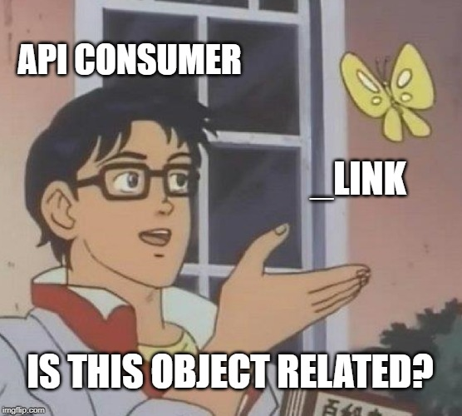
But Seriously What is HATEOAS
Resources link to related information so it is easier to figure out what is available.
That’s it.
{
“name”:”Simon”,
“_links”:{
“self”:{ “href”:”/person/Simon”},
“son”:{ “href”:”/person/Frank”}
}
}

Slide 14

Why use HATEOAS
Makes API discoverable
Consumer no longer responsible for knowing the URI structure
Versioning gets easier
Takes Advantage of Microservices

Slide 15
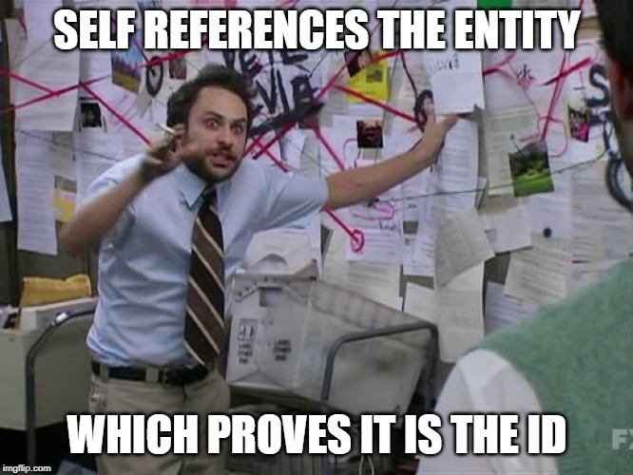
How should HATEOAS?
Establish Relationships
Self Reference
Controller Methods

Slide 16
Thanks, Have Some Links
https://restfulapi.net/
https://www.baeldung.com/spring-hateoas-tutorial
https://github.com/BlakeRhodes/dungeonbase

